Slide 1


Oumar Fara DIOP
23/06/2022

Slide 2

Outline
Executive Summary
Introduction
Methodology
Results
Conclusion
Appendix

Slide 3
Executive Summary
We have collected our data from two sources (public SpaceX API and SpaceX wikipedia page). We used SQL and Python to do the different tasks like creating dashboards and interactive maps. And finally use machine learning to make some predicitions.
We have used K Nearest Neighbors, Support Vector Machine, Logistic Regression and Decision Tree Classifier. The final results were similar

Slide 4
Introduction
Project background :
Space X reduced the cost of rocket by almost 3 times the original price (62 M dollars vs 165 M dollars)
The rockets of Space X can land and be reused.
The company Space Y wants to compete Space X
Problem :
We have to train a machine learning model to predict a successful Stage 1 recovery

Slide 5

Section 1

Slide 6
Methodology
Executive Summary
Data collection methodology:
From public SpaceX API and SpaceX Wikipedia page
Perform data wrangling
Describe how data was processed
Perform exploratory data analysis (EDA) using visualization and SQL
Perform interactive visual analytics using Folium and Plotly Dash
Perform predictive analysis using classification models
We used GridSearchCV

Slide 7
Data Collection
Webscrapping, Data Wrangling, Visualization, Dashboard and Machine learning

Slide 8
Data Collection – SpaceX API
Request (Space X APIs)
Filter data to only include Falcon 9 launches
Imputate missing PayloadMass values with mean
These are the steps we follow
GitHub URL : Data collection API
.JSON file + Lists(Launch Site, Booster Version, Payload Data)
Cast dictionary to a DataFrame
Json_normalize to DataFrame data from JSON
Dictionary relevant data

Slide 9
Data Collection - Scraping
Request Wikipedia
html
Cast dictionary to DataFrame
These are the steps we follow
GitHub URL : Data Webscrapping
BeautifulSoup
html5lib Parser
Iterate through table cells to extract data to dictionary
Find launch info html table
Create dictionary

Slide 10
Data Wrangling
We created a training label with landing outcomes where successful = 1 and failure = 0.
Outcome column has two components: ‘Mission Outcome’ and ‘Landing Location’
New training label column ‘class’ with a value of 1 if ‘Mission Outcome’ is True and 0 otherwise. Value Mapping:
True ASDS, True RTLS, & True Ocean – set to -> 1
None None, False ASDS, None ASDS, False Ocean, False RTLS – set to -> 0
GitHub URL: Data Wrangling

Slide 11

Section 2

Slide 12
EDA with Data Visualization
We performed Exploratory Data Analysis on variables Flight Number, Payload Mass, Launch Site, Orbit, Class and Year.
Plots Used:
Flight Number vs. Payload Mass, Flight Number vs. Launch Site, Payload Mass vs. Launch Site, Orbit vs. Success Rate, Flight Number vs. Orbit, Payload vs Orbit, and Success Yearly Trend
Scatter plots, line charts, and bar plots were used to compare relationships between variables to decide if a relationship exists so that they could be used in training the machine learning model
GitHub URL : EDA with Data Visualization

Slide 13
EDA with SQL
We loaded data set into IBM DB2 Database.
We queried using SQL Python integration.
We made some queries to get a better understanding of the dataset.
We queried information about launch site names, mission outcomes, various pay load sizes of customers and booster versions, and landing outcomes
GitHub URL : EDA with SQL

Slide 14
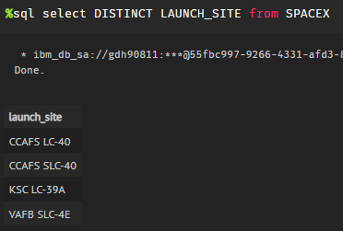
All Launch Site Names
The query to show unique launch site names. The two first sites are the same

Slide 15
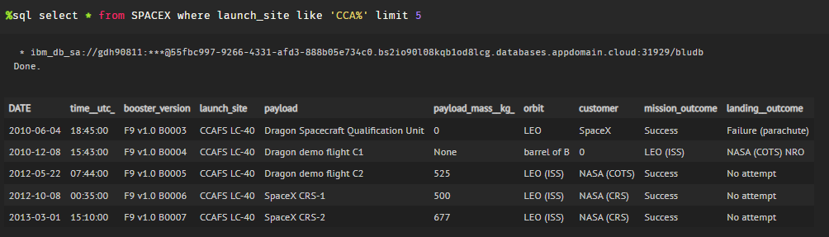
Launch Site Names Begin with 'CCA'
The five first entries of the dataset with launch site name beginning with CCA

Slide 16
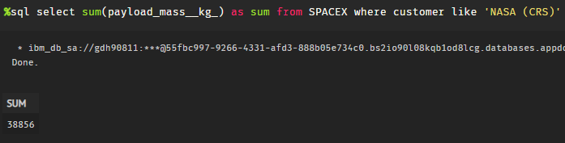
Total Payload Mass
With this query we can show the total payload mass in kg where NASA is the customer

Slide 17
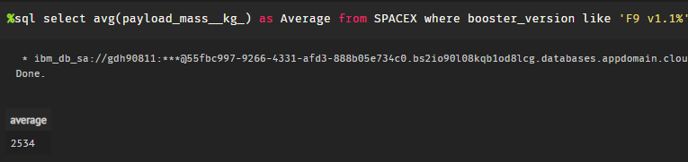
Average Payload Mass by F9 v1.1
This query calculates the average payload mass or launches which used booster version F9 v1.1

Slide 18
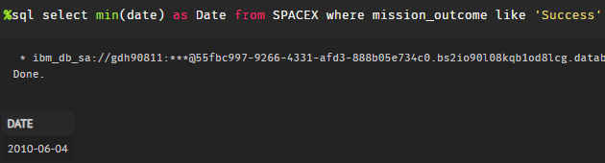
First Successful Ground Landing Date
This query returns the first successful ground pad landing date. It was the 04/06/2010

Slide 19
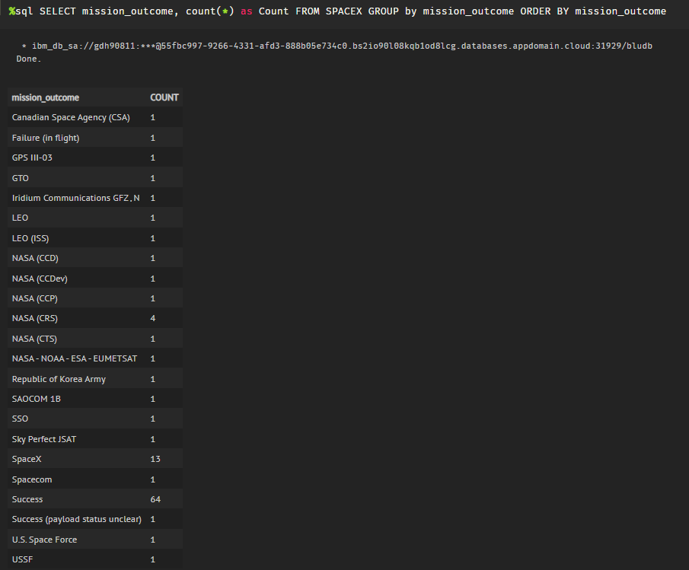
Total Number of Successful and Failure Mission Outcomes

Slide 20

Section 3

Slide 21
Build an Interactive Map with Folium
We used Folium maps to mark Launch Sites, successful and unsuccessful landings, and a proximity example to key locations: Railway, Highway, Coast, and City.
This allows us to understand why launch sites may be located where they are. Also visualizes successful landings relative to location.
GitHub URL : Interactive map with Folium

Slide 22
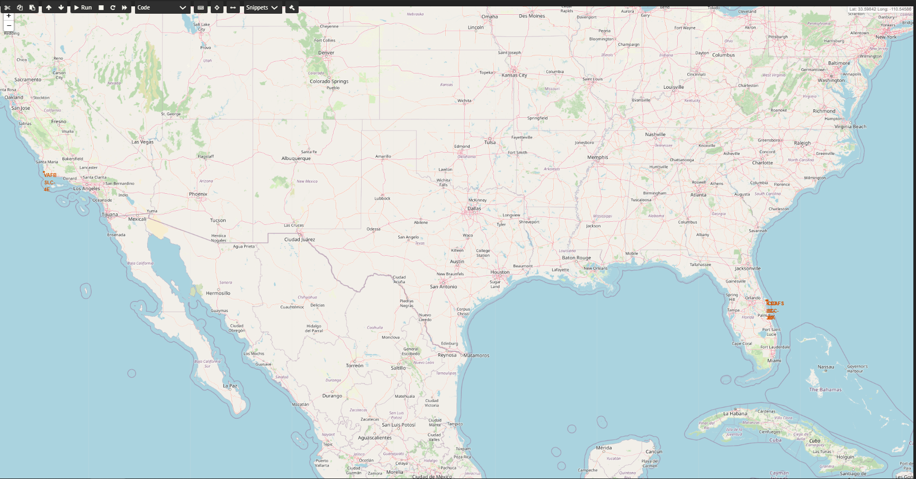
Locations of Launch Site
The sites are located on opposite places.
But we can see that they are all near the ocean.

Slide 23
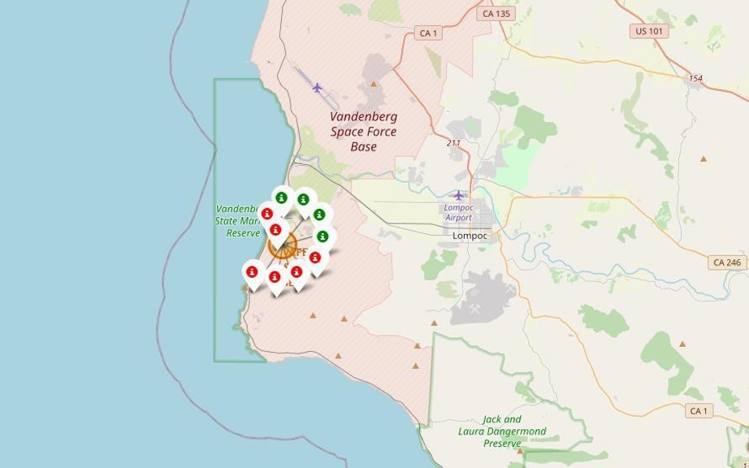
Color coded launch markers
Clusters on Folium map can be clicked on to display each successful landing (green icon) and failed landing (red icon). In this example VAFB SLC-4E shows 4 successful landings and 6 failed landings.

Slide 24
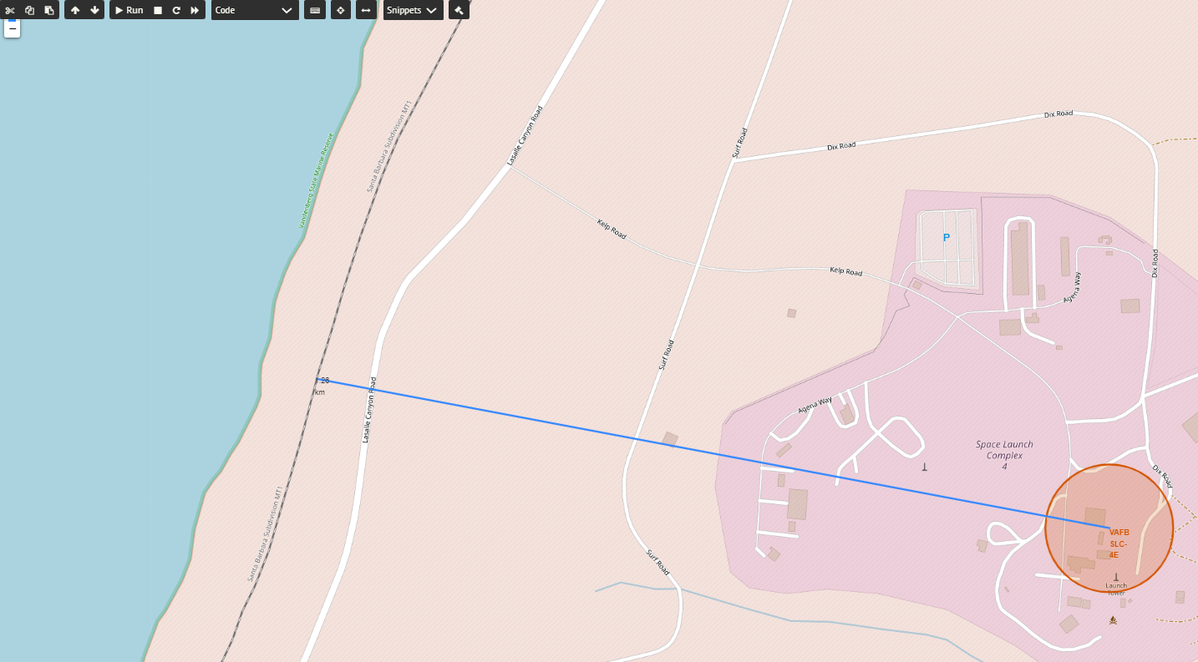
Location proximity
We can see that VAFB SLC-4E is 1.26 km far from the railway

Slide 25

Section 4

Slide 26
Build a Dashboard with Plotly Dash
Dashboard includes a pie chart and a scatter plot.
Pie chart can be selected to show distribution of successful landings across all launch sites and can be selected to show individual launch site success rates.
Scatter plot takes two inputs: All sites or individual site and payload mass on a slider between 0 and 10000 kg.
The pie chart is used to visualize launch site success rate.
The scatter plot can help us see how success varies across launch sites, payload mass, and booster version category.
GitHub URL : Dashboard with Plotly Dash

Slide 27
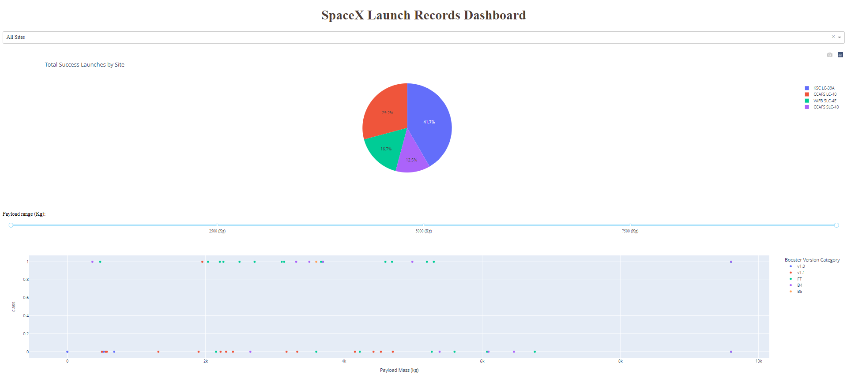
Results
This is a preview of the Plotly dashboard.It’s interactive and show statistics for different launch site.

Slide 28
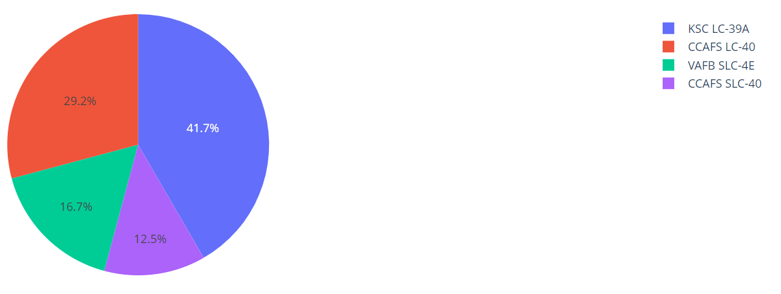
Percentage of successful launches on launch sites
This is the distribution of successful landings across all launch sites. CCAFS LC-40 and CCAFS SLC-40 are the same so CCAFS and KSC have the same amount of successful landings.VAFB has the smallest share of successful landings.

Slide 29
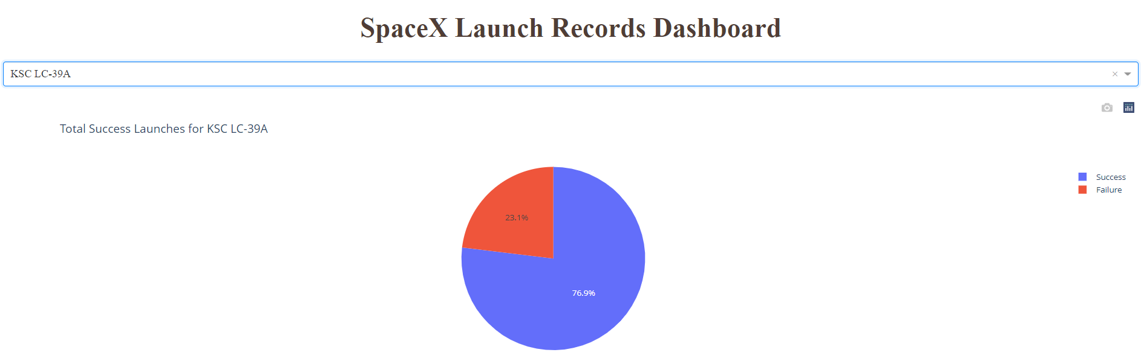
Highest Success Rate Launch Site
KSC LC-39A has the highest success rate with 10 success and 3 fails

Slide 30
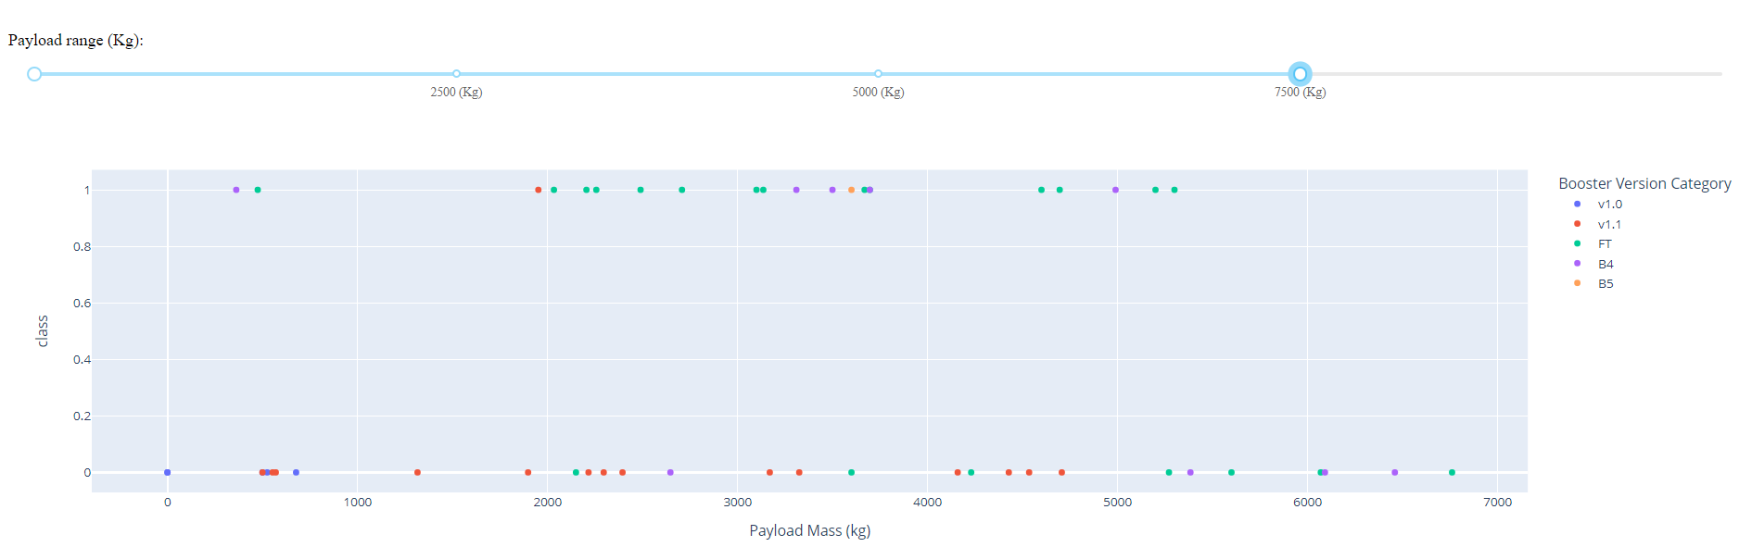
Payload vs Launch outcome
Plotly dashboard has a Payload range selector. However, this is set from 0-7500. Class indicates 1 for successful landing and 0 for failure. Scatter plot also accounts for booster version category in color and number of launches in point size.

Slide 31
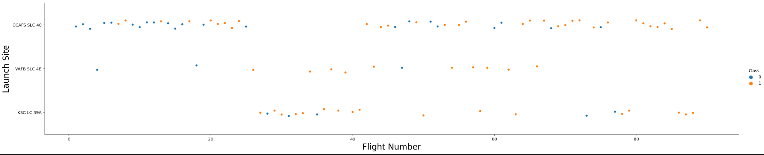
Flight Number vs. Launch Site
Orange means it’s a successful launch; Blue means unsuccessful launch.
We can see that the success rate increases with time. The increase start after the 20th flight. CCAFS has the most successful launch.

Slide 32
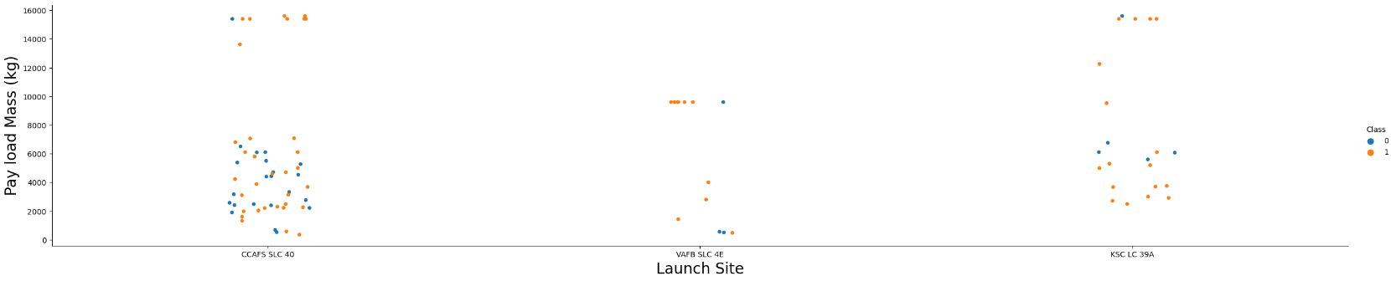
Payload vs. Launch Site
Orange means it’s a successful launch; Blue means unsuccessful launch.
The launch sites use different payload mass. But the majority of the payload mass are between 0-6000kg.

Slide 33
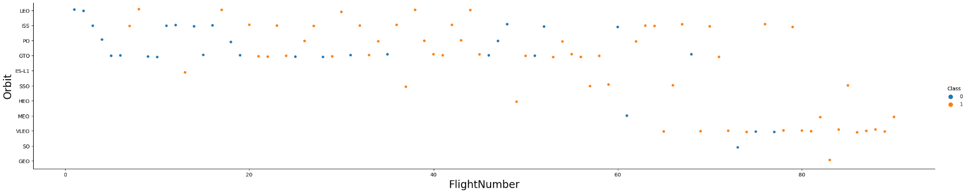
Flight Number vs. Orbit Type
Orange means it’s a successful launch; Blue means unsuccessful launch.
Graphic suggests an increase in success rate over time (indicated in Flight Number). Likely a big breakthrough around flight 20 which significantly increased success rate. CCAFS appears to be the main launch site as it has the most volume.

Slide 34
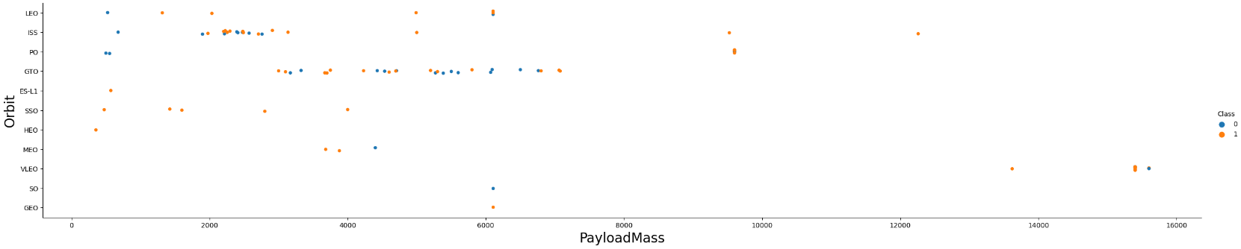
Payload vs. Orbit Type
Orange means it’s a successful launch; Blue means unsuccessful launch.
Payload mass appears to fall mostly between 0-6000 kg. Different launch sites also seem to use different payload mass.

Slide 35
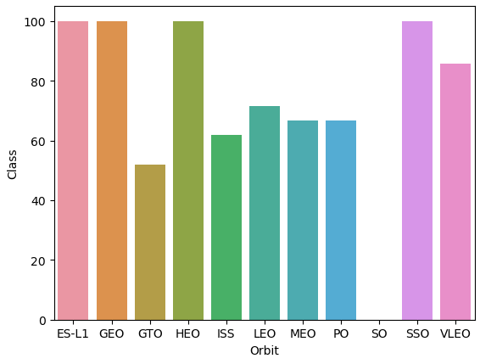
Success Rate vs. Orbit Type
We can see that ES-L1, GEO, HEO and SSO have 100% success rate.
Followed by VLEO with almost 85%, LEO with 70%.
MEO and PO have almost 65%.
ISS have just over 60%.
GTO have 50%
SO have 0%

Slide 36
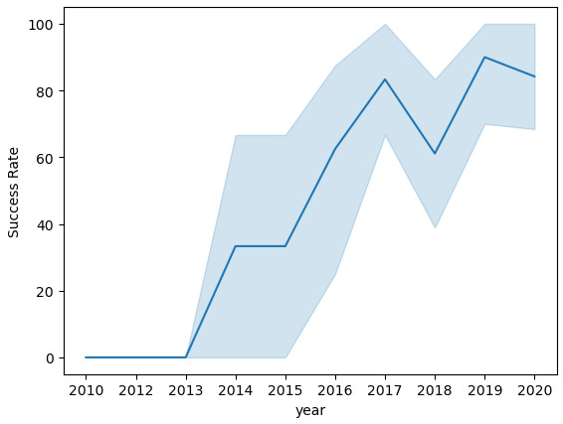
Launch Success Yearly Trend
We can see that success rate increases over time since 2013.
Just a reduction of success rate in 2018

Slide 37

Section 5

Slide 38
Predictive Analysis (Classification)
Split label column
Score models on
Confusion Matrix
‘Class’ from dataset
split test set
for all models
GitHub URL: Machine Learning
Fit and Transform
Use GridSearchCV
Features using
on LogReg, SVM,
Barplot to compare scores of models
Standard Scaler
Decision Tree, and
KNN models
Train_test_split
GridSearchCV
data
(cv=10) to find optimal parameters

Slide 39
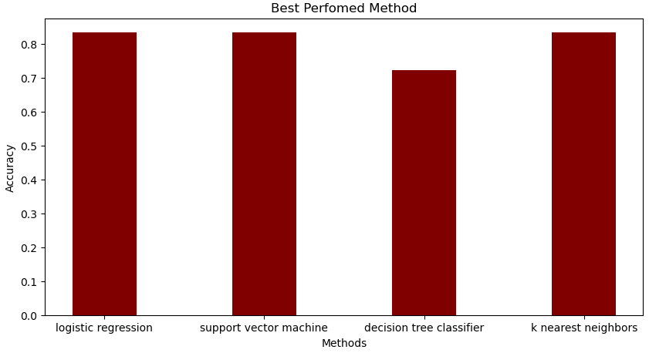
Classification Accuracy
The logistic regression, support vector machine and k nearest neighbors have the same accuracy. We will need more data to find the more suitable model.

Slide 40
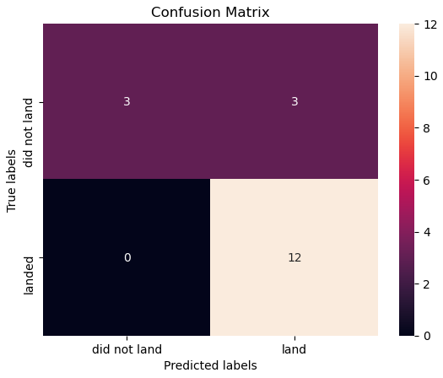
Confusion Matrix
Since all models performed the same for the test set, the confusion matrix is the same across all models. The models predicted 12 successful landings when the true label was successful landing.
The models predicted 3 unsuccessful landings when the true label was unsuccessful landing.
The models predicted 3 successful landings when the true label was unsuccessful landings (false positives). Our models over predict successful landings.

Slide 41
Conclusions
We tried to develop a machine learning model for Space Y
We used data from a public SpaceX API and web scraping SpaceX Wikipedia page
We created data labels and stored data into a DB2 SQL database
We created a dashboard for visualization
We created a machine learning model with an accuracy of 83%
We had 3 models that show the same accuracy
We’ll need more data to determine the best machine learning model and improve accuracy

Slide 42


